Slide 1
Analysis of single-cell RNA-seq data (III)
Hao Wu
Department of Biostatistics and Bioinformatics
Rollins School of Public Health
Emory University
Ziyi Li
Department of Biostatistics
The University of Texas MD Anderson Cancer Center
ENAR 2021 short course
March 2021

Slide 2
Course outline
8-9:15: Intro and data preprocessing.
9:15-9:45: Lab: preprocessing and visualization.
10-11:15: Normalization, batch effect, imputation, DE, simulator.
11:15-12: Lab: Normalization, batch effect, imputation, DE, simulator
12-1: Lunch break
1-2: Clustering and pseudotime construction
2-2:30: Lab: Clustering and pseudotime construction
2:45–3:30: Supervised cell typing & related single cell data sources
3:30-4: Lab: supervised cell typing.
4:15-5: scRNA-seq in cancer

Slide 3
Outline for this session
Background
Scientific motivation
Assumptions and challenges
Clustering
Existing methods
Performance comparisons and considerations
Pseudotime construction
Existing methods
Pros and Cons
Future directions

Slide 4
Example scRNA-seq analysis workflow
Kiselev et al. (2019) Nat. Rev. Genet.

Slide 5
Scientific motivations
Subpopulation (cell type) identification is a fundamental step for many scRNA-seq data analyses
Consistent and rigorous definition of cell type is elusive:
Early days, physical appearance, e.g. size, shape
Later, presence or absence of surface proteins
scRNAseq: define cell type based on transcriptome similarities
Goal: discover the natural groupings of measured cells, discrete or continuous

Slide 6
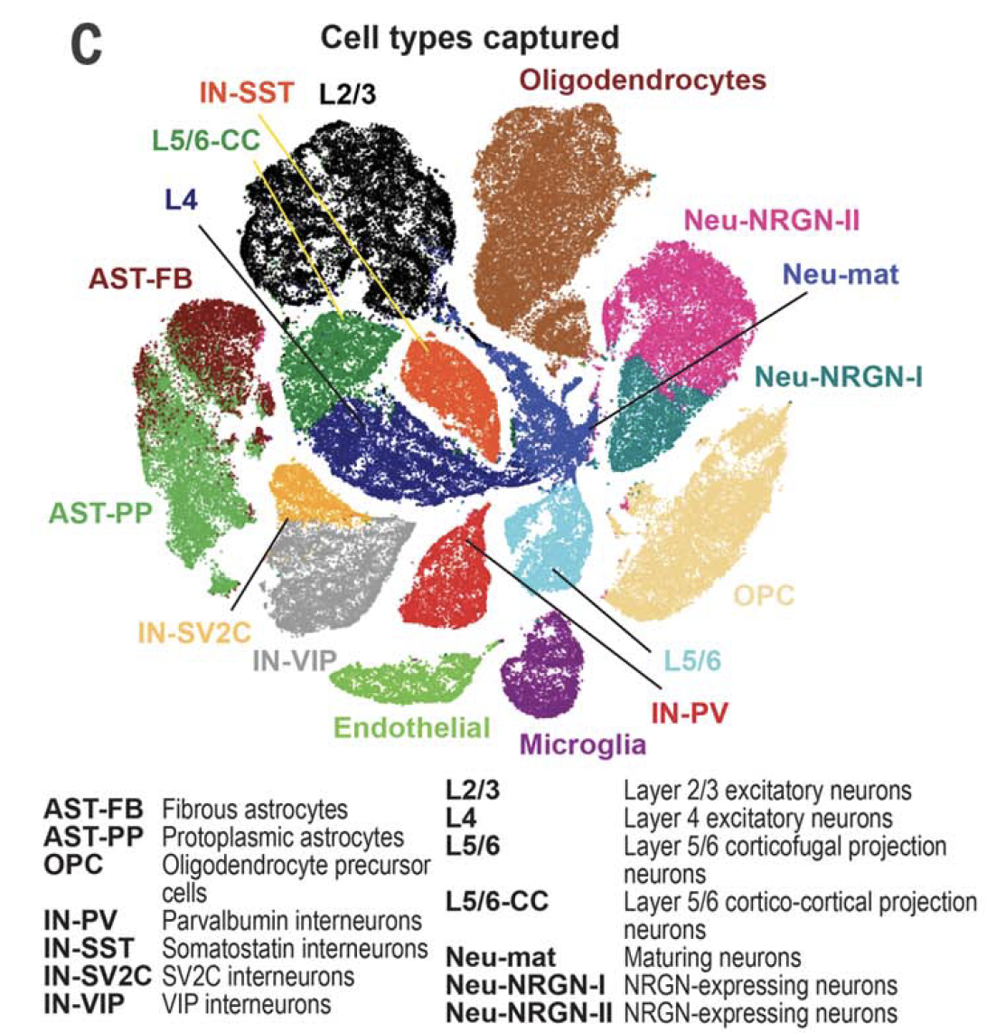
Velmeshev et al., (2019) Science

Slide 7
Assumptions
Clustering: discrete groups of cells present in the data.
If assumption not hold, clustering methods still partition the data, and thus mistake random noise for true structure (!)
Pseudotime construction:
place cells on a continuum connecting two or more end states
useful for understanding development or disease progression
Strategies bridging the two approaches: soft or fuzzy clustering
When assumptions are not clear, explore both

Slide 8
Existing clustering methods
K-means based
RaceID (Grun et al. 2015 Nature)
SC3 (Kiselev et al. 2017 Nat methods)
SIMLR (Wang et al. 2017 Nat Methods)
Hierarchical clustering based
CIDR (Lin et al. 2017 Genome Biology)
pcaReduce (Zeisel et al. 2016 BMC Bioinfo)
Ascend (Senabouth et al. 2019 Gigascience)
SINCERA (Guo et al. 2015 Plot Comp Biology)
BackSPIN (Zeiselet al. 2015 Science)
Graph or community-detection based
Seurat (Macosko et al. 2015 Cell)
Scanpy (Wolf et al. 2018 Genome Biology)
PhenoGraph (Levin et al. 2015 Cell)
Model based clustering
TSCAN (Ji and Ji, 2015 NAR)
monocle (Trapnell, 2014 Nat Biotech)

Slide 9
Existing cell clustering methods
K-means based clustering methods
Iteratively identifies k cluster centroids, and each cell is assigned to the closest centroid
Advantage: scaling linearly with the number of points, can be applied to large datasets
Drawback 1: the algorithm is greedy. Global minimum is not guaranteed.
A solution: repeat the process using different initialization and find consensus result, SC3
Drawback 2: bias towards identifying equal-sized clusters. Rare cell types could be hidden in large clusters.
A solution: combine K-means cluster with outlier detection, RaceID

Slide 10
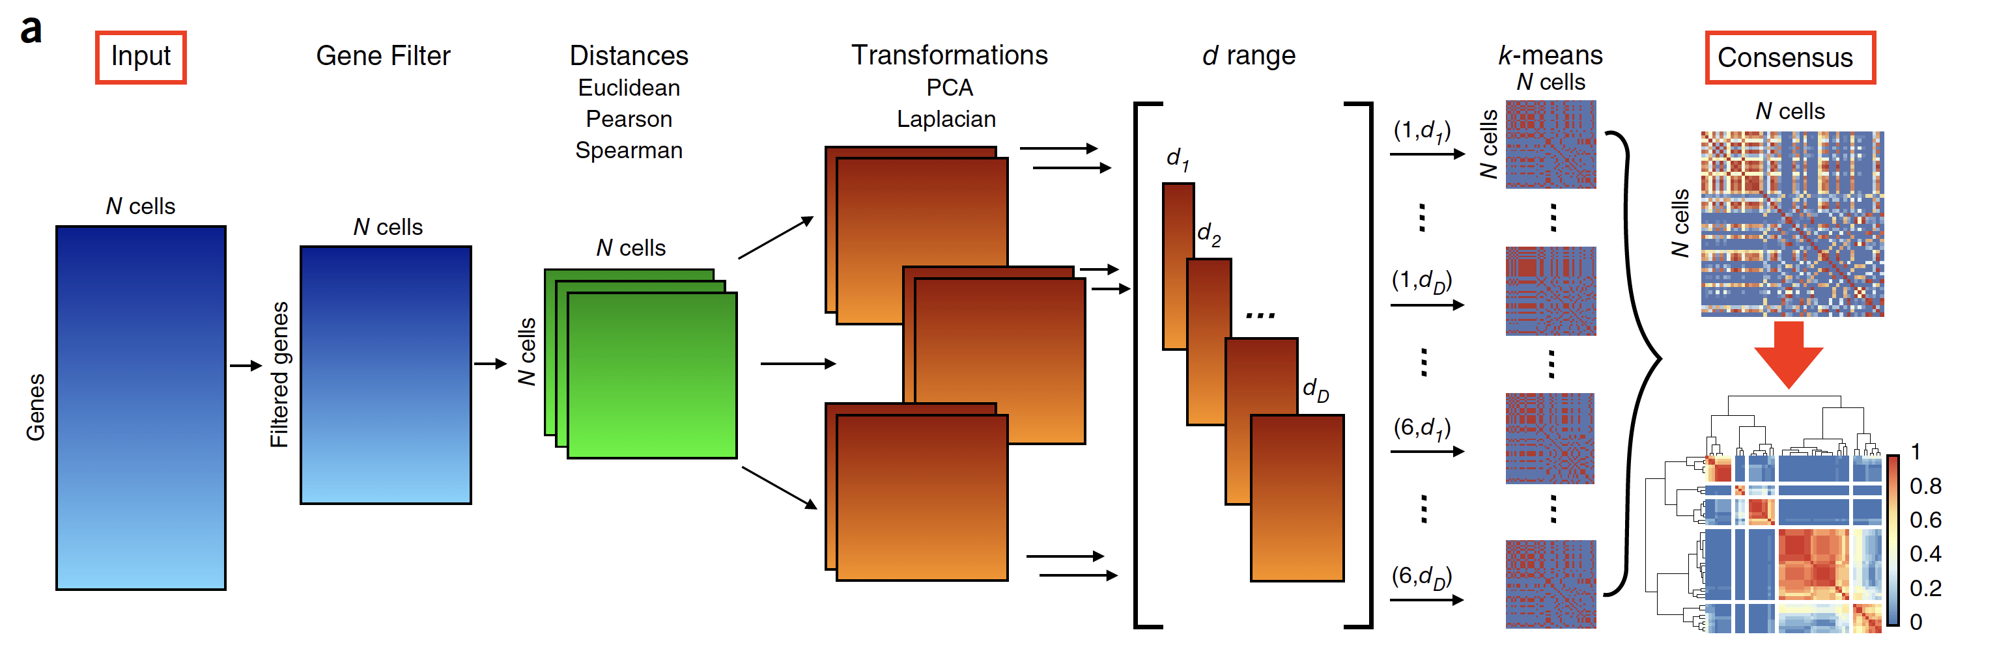
SC3

Slide 11
SC3
Most important step: combines all the different clustering outcomes into a consensus matrix that summarizes how often each pair of cells is in the same cluster.
The final result is determined by complete-linkage hierarchical clustering of the consensus matrix into k groups.

Slide 12
Existing cell clustering methods
Hierarchical clustering-based methods
Sequentially combines individual cells into larger clusters (agglomerative) or divides clusters into smaller groups (divisive)
Drawback: both time and memory requirements scale at least quadratically with the number of data points. Does not scale well with large dataset.
CIDR adapts hierarchical clustering for scRNA-​seq by adding an implicit imputation of zeros into the distance calculation – more stable
Notes:
WH: I think k-means methods also have this problem. They have to compute pair-wised distances for cells, thus also quadratic.

Slide 13
Existing cell clustering methods
Graph or community-detection based
Instead of identifying groups of points that are close together, community detection identifies groups of nodes that are densely connected
Construct a k-nearest-neighbour graph first, then apply community-detection algorithm on the graph. The most popular one is the Louvain algorithm
Disadvantage: selection of k impacts the number and size of the final clusters
Advantage: users don’t need to specify number of clusters

Slide 14
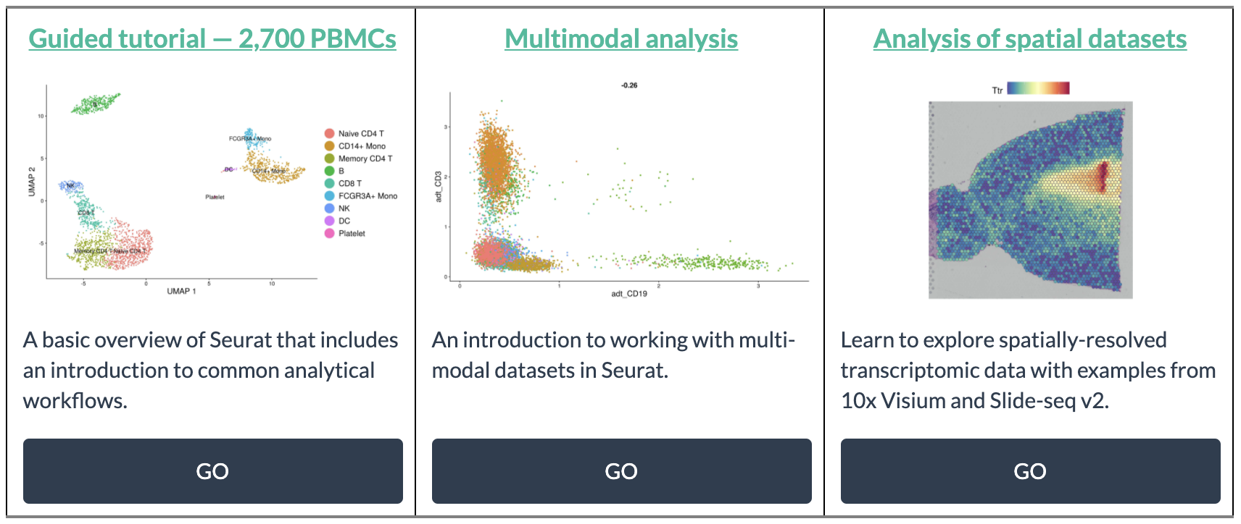
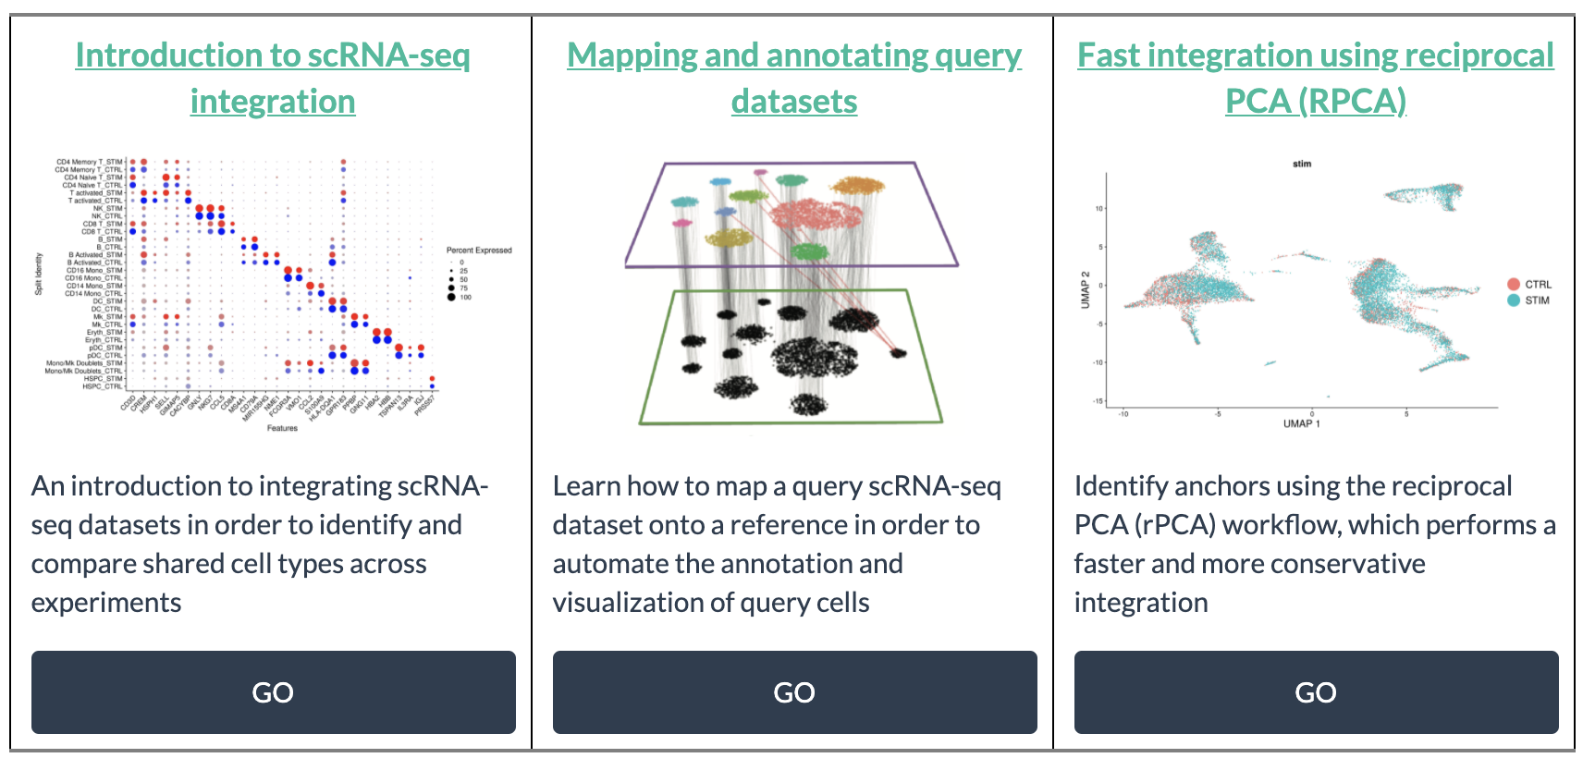
Seurat

Slide 15
Cell clustering methods
Duo et. al (2018) F1000 Research

Slide 16
SHARP (Genome Research, 2020)
Hyperfast and accurate clustering of scRNA-seq data
Based on ensemble random projection
RP (Bingham and Mannila 2001) is a powerful dimension-reduction method that reduces the dimension while the distances between the points are approximately preserved
RP is very fast because it does not require calculation of pairwise cell-to-cell distances or principal components

Slide 17
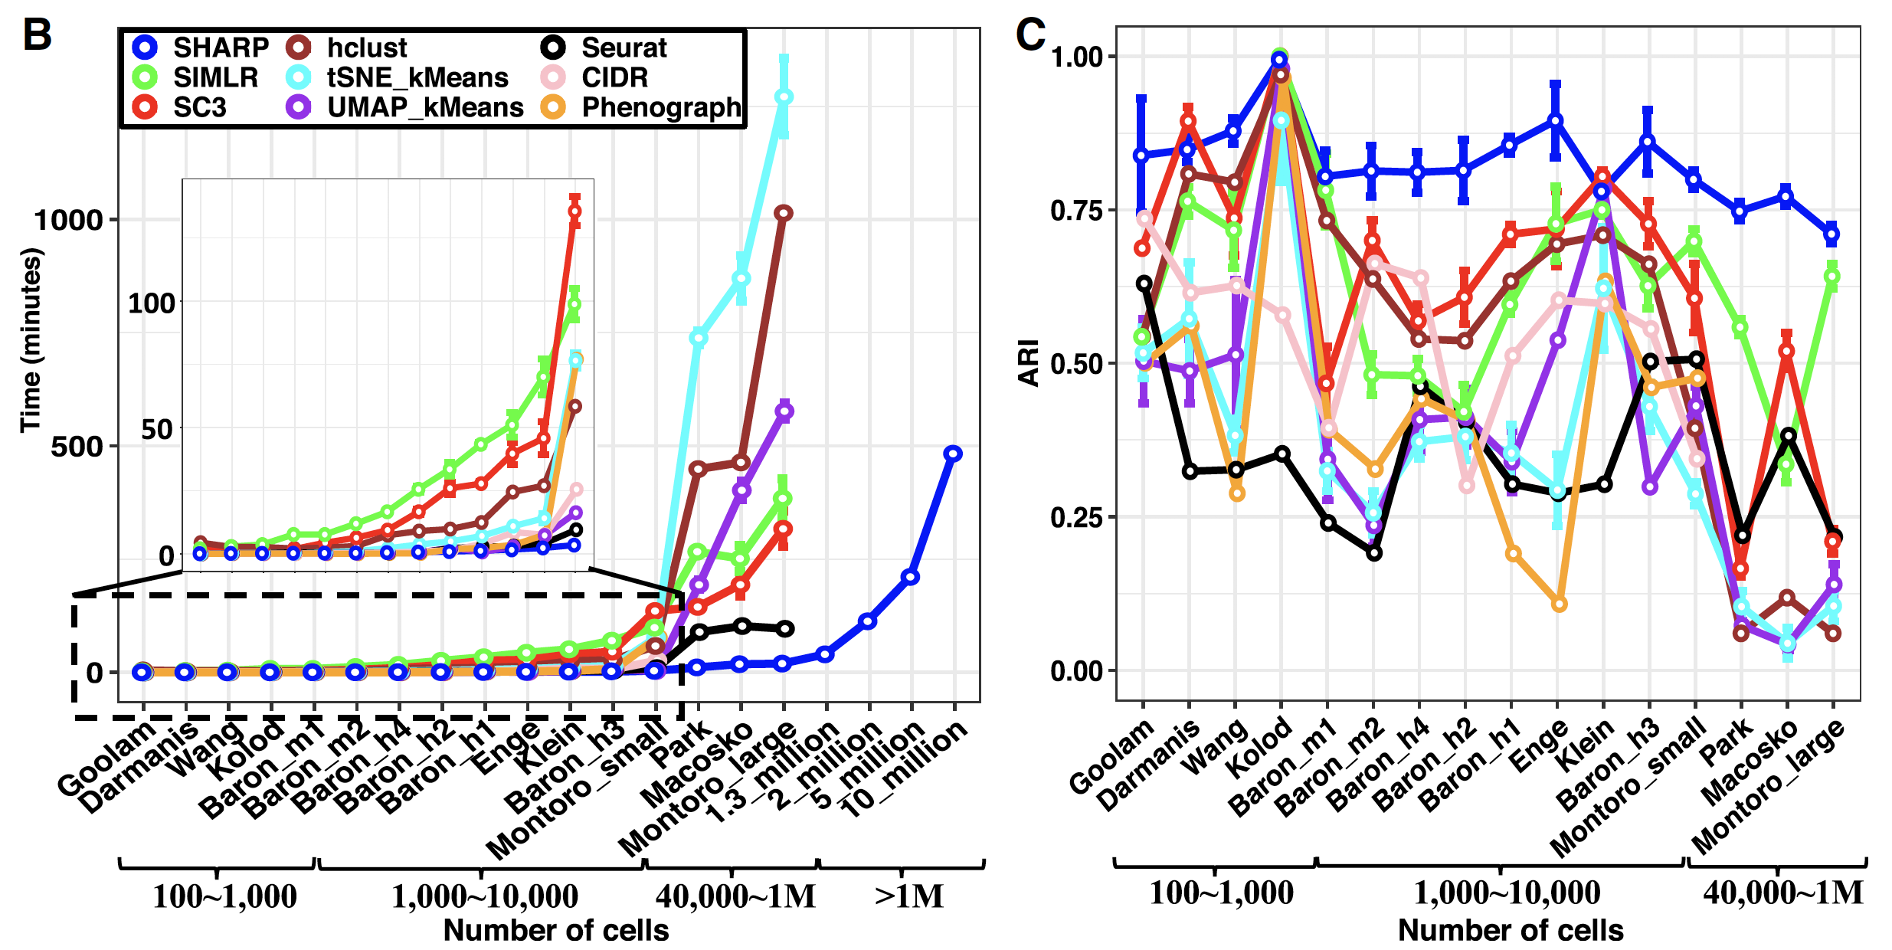
SHARP (Genome Research, 2020)

Slide 18
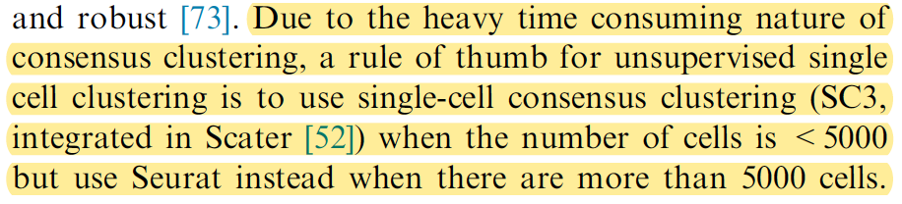
Performance comparisons and considerations
Due to speed and scalability, SHARP or Seurat or scanpy is the top choice for large data set
Louvain-based method does not have good accuracy in smaller data set
SC3 has been shown to have the highest clustering accuracy, but is the slowest
For rare cell type detection, RaceID and GiniClust should be considered. But they perform poorly if no rare cell type exists.
Mu et al. Genomics Proteomics Bioinformatics (2019)

Slide 19
Example codes for SC3
sce = SingleCellExperiment(
assays = list(
counts = as.matrix(counts),
logcounts = log2(as.matrix(counts) + 1)
)
)
sce = sc3_prepare(sce)
if( missing(K) ) { ## estimate number of clusters
sce = sc3_estimate_k(sce)
K = metadata(sce)$sc3$k_estimation
}
sce <- sc3(sce, ks = K, biology = TRUE, n_cores = 4)
head(col_data[ , grep("sc3_", colnames(col_data))])
sc3clusters <- col_data$sc3_5_clusters

Slide 20
Example code for Seurat
seuset = CreateSeuratObject( counts )
seuset = NormalizeData(object = seuset)
seuset = FindVariableFeatures(object = seuset)
seuset = ScaleData(object = seuset)
seuset = RunPCA(object = seuset)
seuset = FindNeighbors(object = seuset)
seuset = FindClusters(object = seuset)
Result = seuset@active.ident

Slide 21
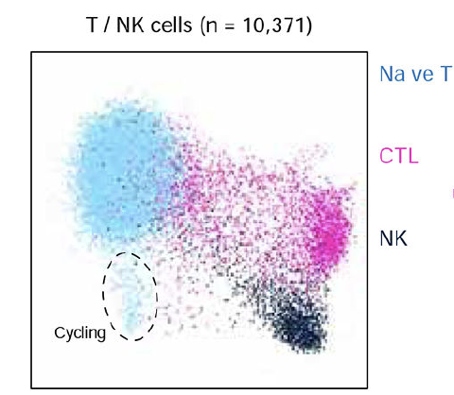
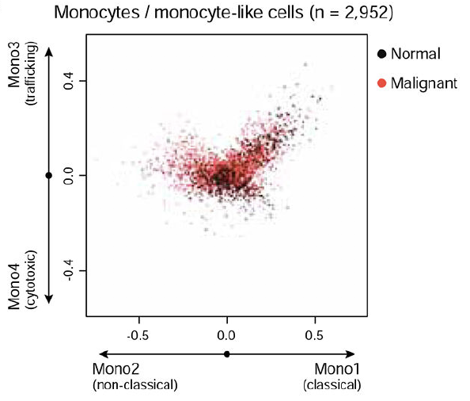
Sub-cluster identification
After major clusters or cell types are identified, recursive clustering could be applied to define finer cell types
Galen et al. 2019. Cell

Slide 22
Challenges of clustering methods
Technical challenges
Dropout: imputation methods available, but all rely on existing observations
Technical noise: spike-in RNA can be used for normalization.
Batch effect is especially hard to correct in scRNA-seq. Batch effects can have a large impact on clustering. Balanced experimental design is hard to implement for perishable samples used in scRNA-seq.
Multiple sample clustering

Slide 23
Cell clustering for multiple samples
When scRNA-seq data are from multiple samples, batch/subject effects could have significant impact on the results.
Cells from the same sample, instead of the same cell type form different sample, can cluster together.
Possible solution:
Remove batch effect then cluster: MNN + SC3
Jointly model cell type and sample effect: BAMM- SC (Sun et al. 2019, Nat. Comm), BUSseq (Song et al. 2020, Nat. Comm), DESC (Li et al. 2020, Nat. Comm), CarDEC (Lakkis et al. 2021+)
Is an active research field

Slide 24
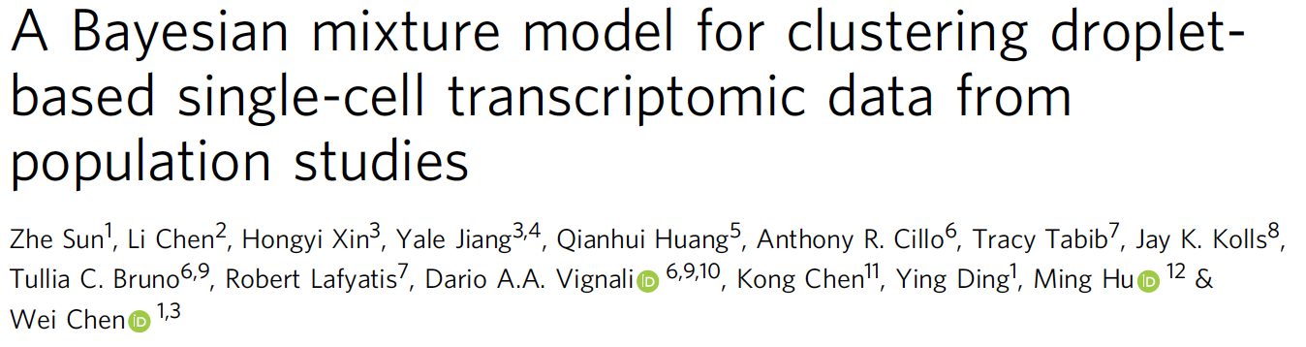
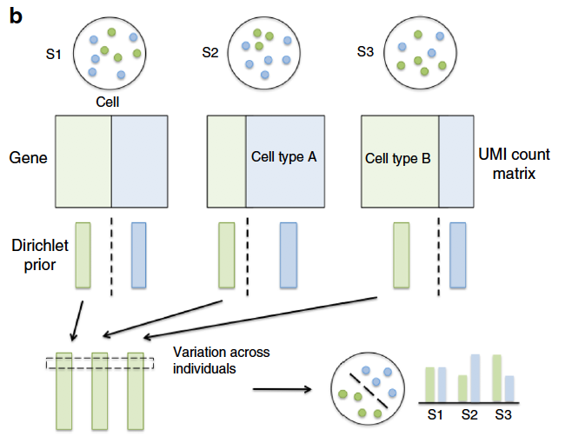
Multiple subject clustering
BAMM-SC
Bayesian hierarchical Dirichlet multinomial mixture model
Impose cell type-specific Dirichlet prior when modeling each individual
Solve by Gibbs Sampler

Slide 25
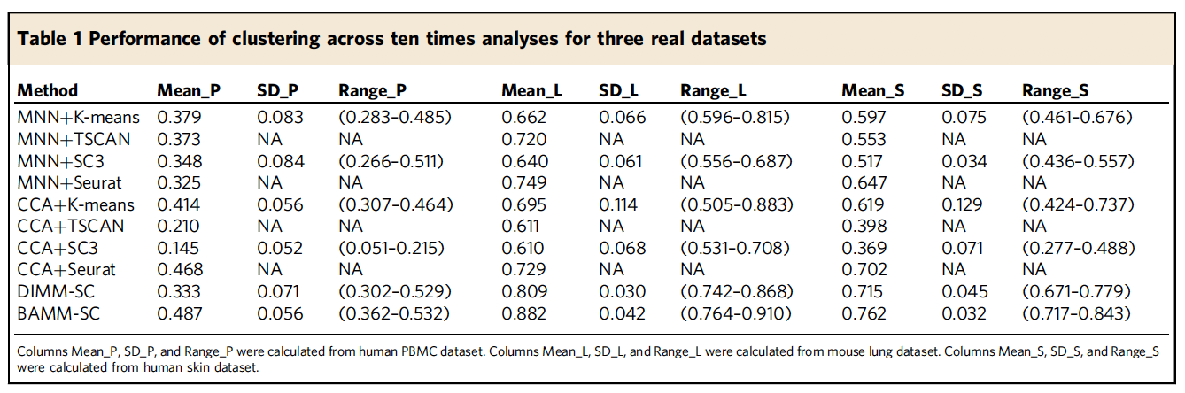
Multiple subject clustering

Slide 26
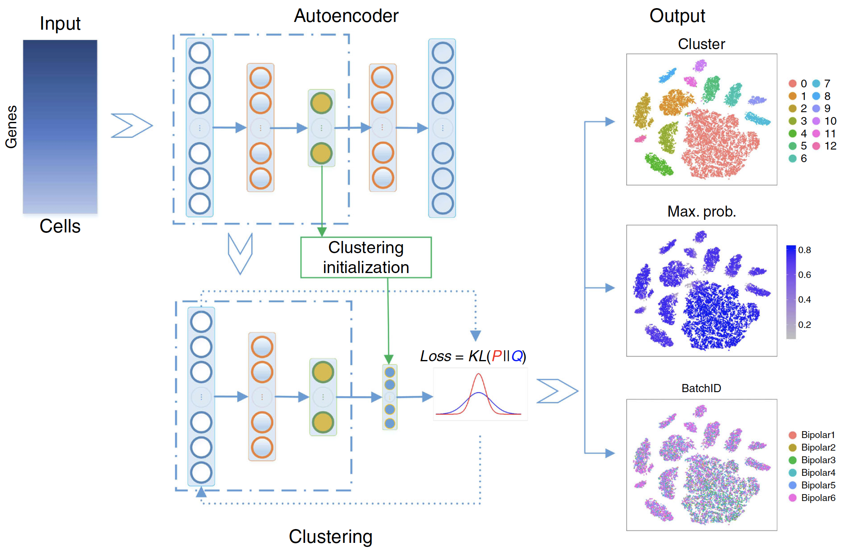
DESC (Li et al. 2020, Nat. Comm)

Slide 27
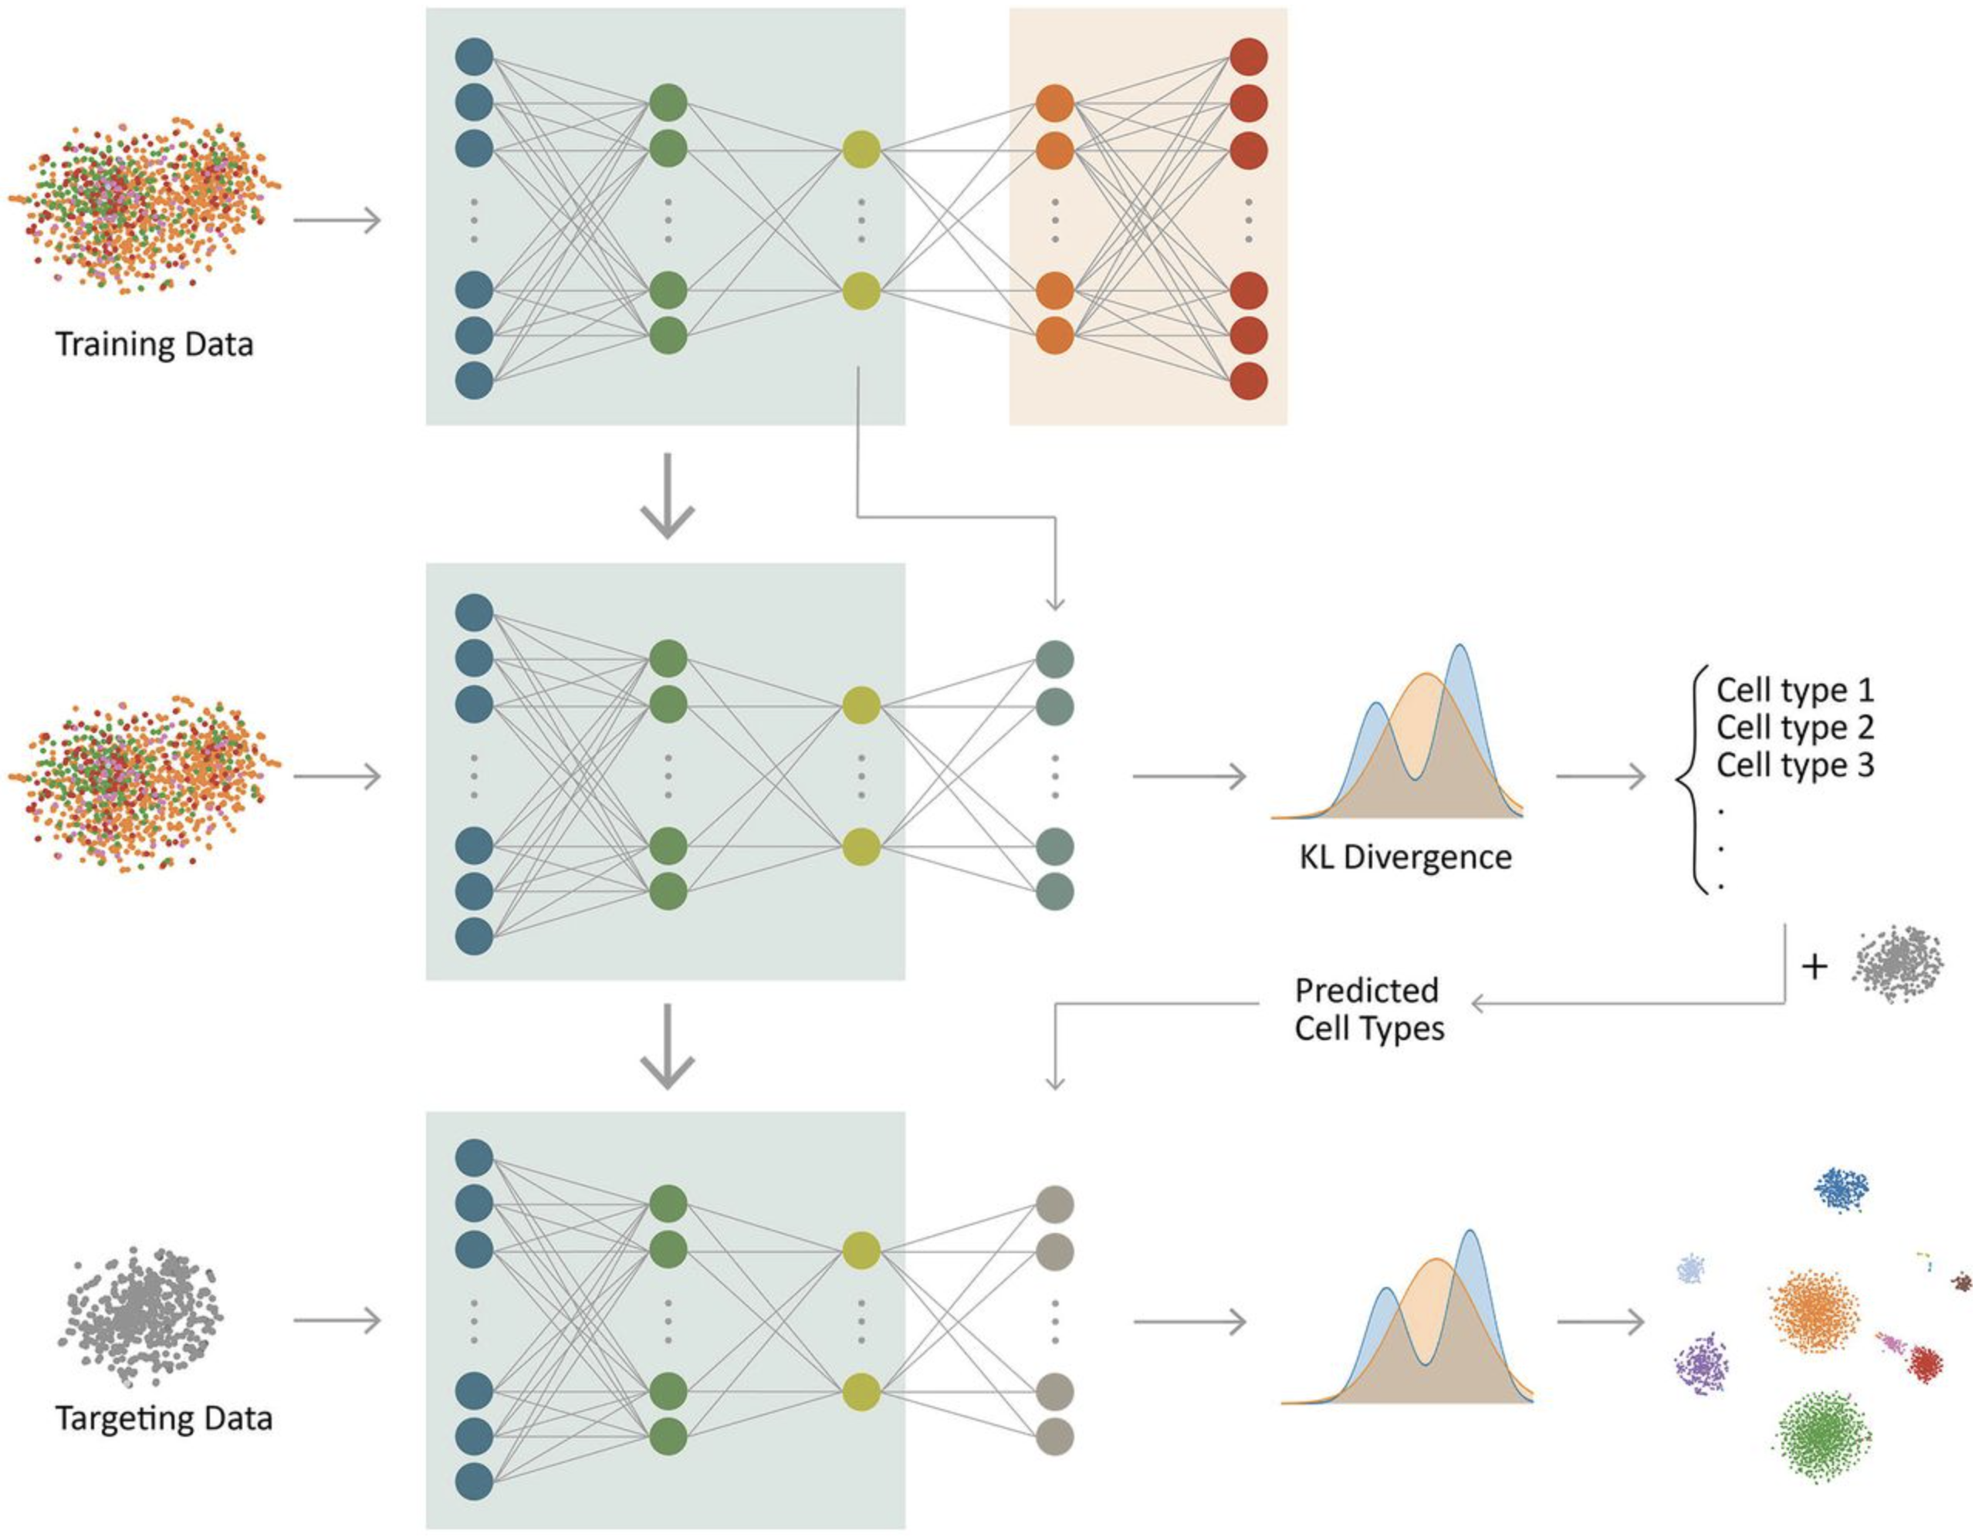
itClust (Hu et al. 2020, Nat. Machine Intelligence)

Slide 28
Pseudotime construction
This belongs to the “clustering” category. Do not have discrete cluster numbers.
Instead of putting cells into independent, exchangeable groups, it orders the cells by underlying temporal stage (estimated).
Methods/tools:
Monocle/monocle2: Trapnell et al. (2014) Nat. Biotechnol; Qiu et al. (2017) Nat. Methods.
Waterfall: Shin et al. (2015) Cell Stem Cell
Wanderlust: Bendall et al. (2014) Cell
TSCAN: Ji et al. (2016) NAR

Slide 29
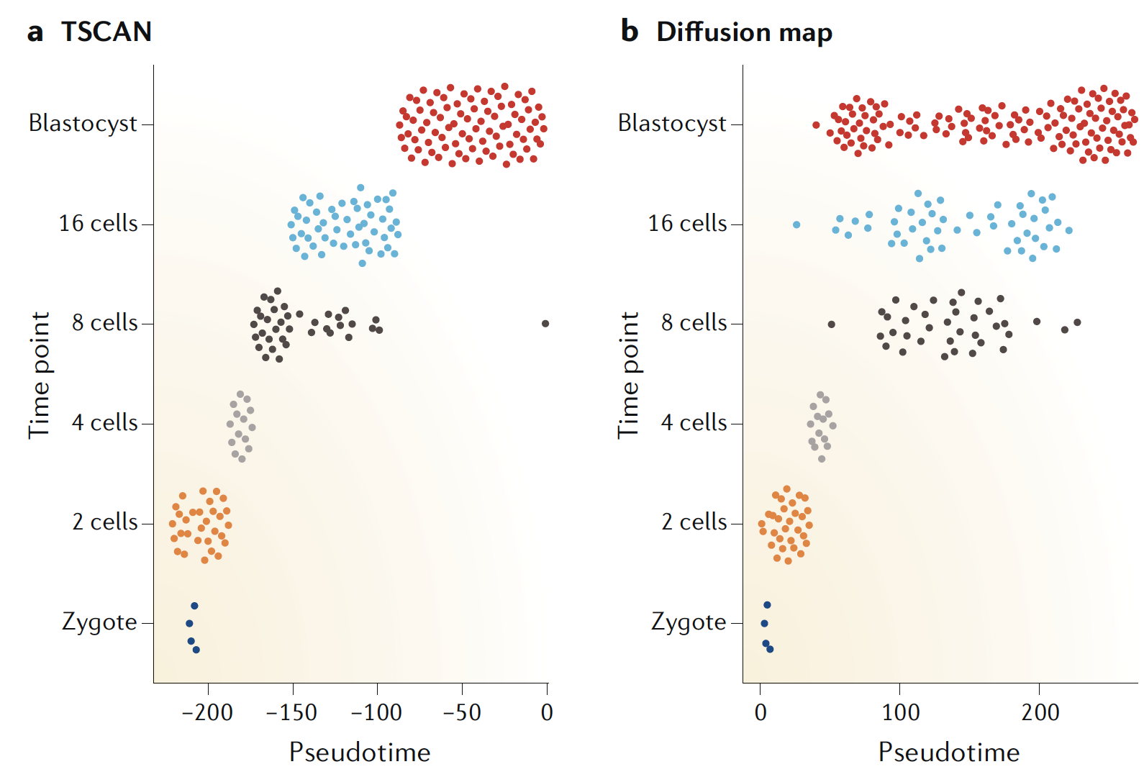
Kiselev et al. 2009. Nat Review Genetics

Slide 30
Pseudotime construction method
General steps:
Select informative genes.
Dimension reduction of GE.
Cluster the cells based on reduced data. Often want to over-cluster them to have many groups.
Construct an MST (minimum spanning tree) from the clustering results.
Map cells to the MST.

Slide 31
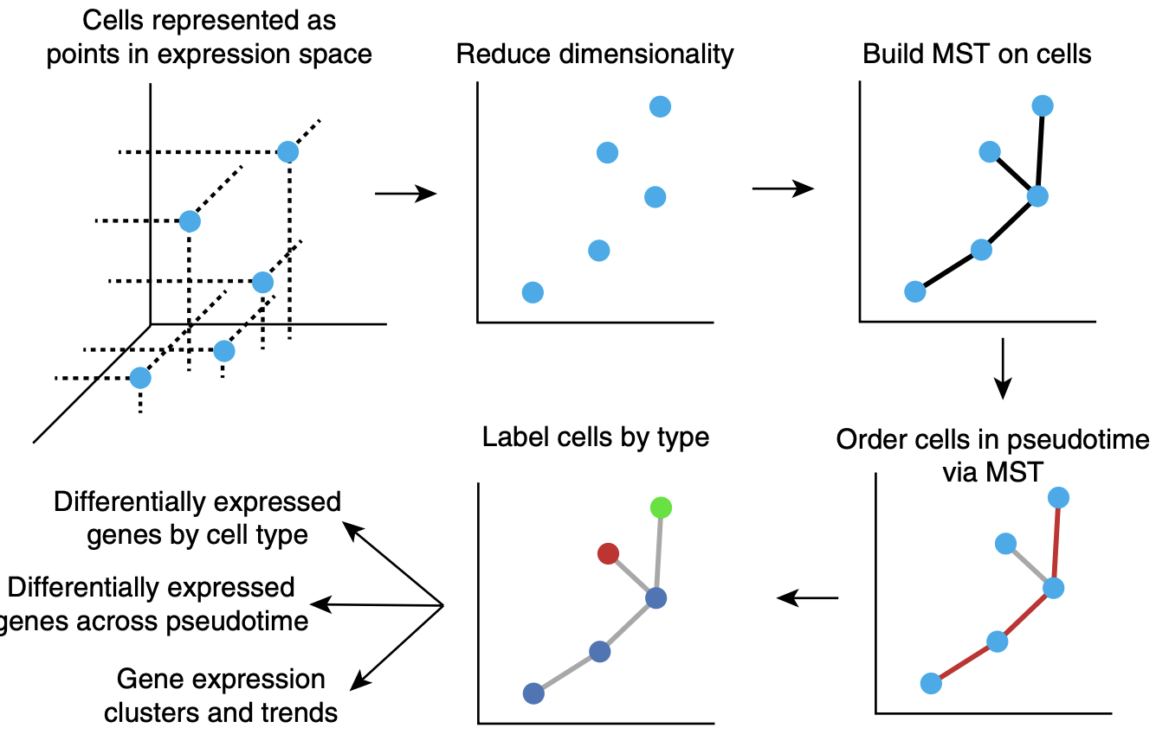
Monocle

Slide 32
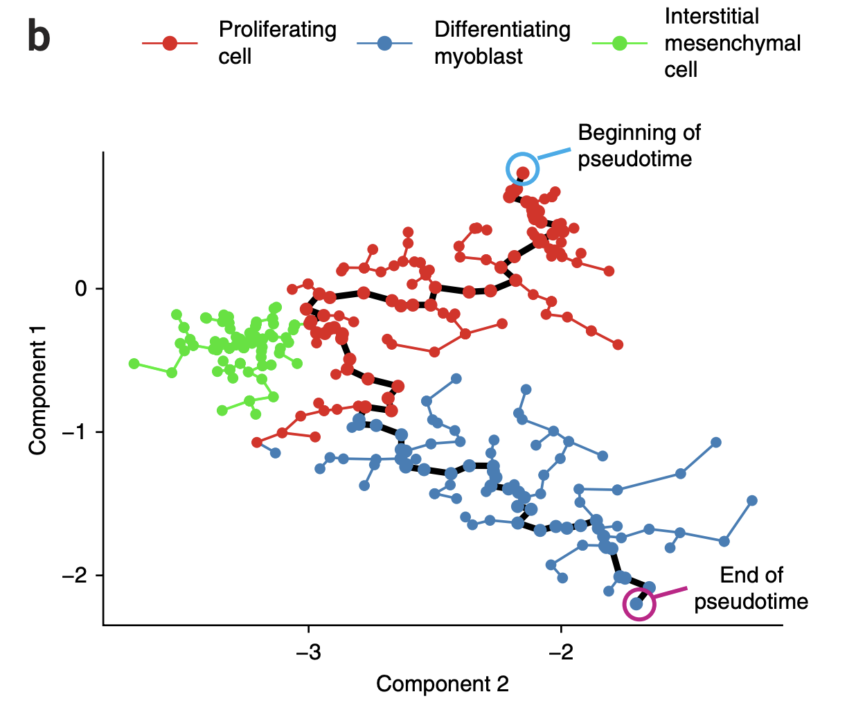
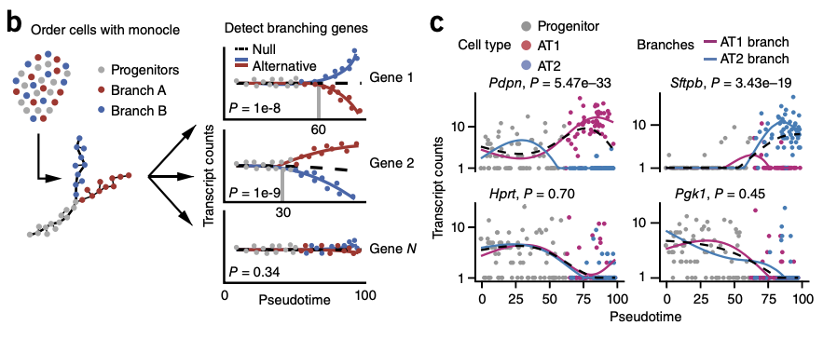
Monocle (v1: 2014, v2: 2017, v3: preprint)

Slide 33
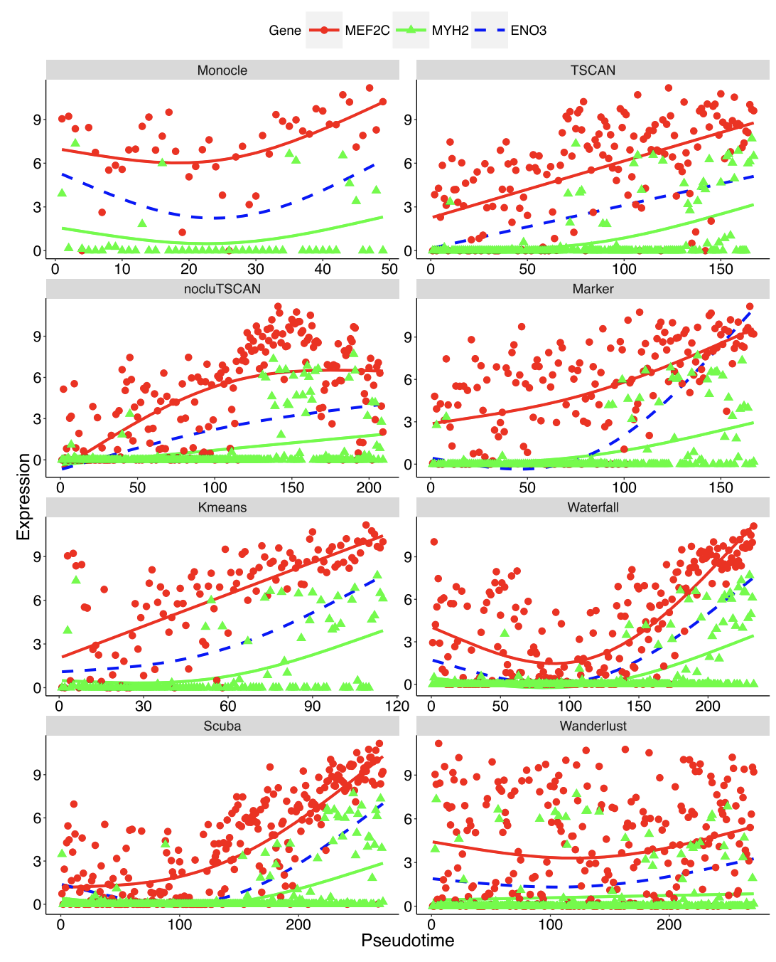
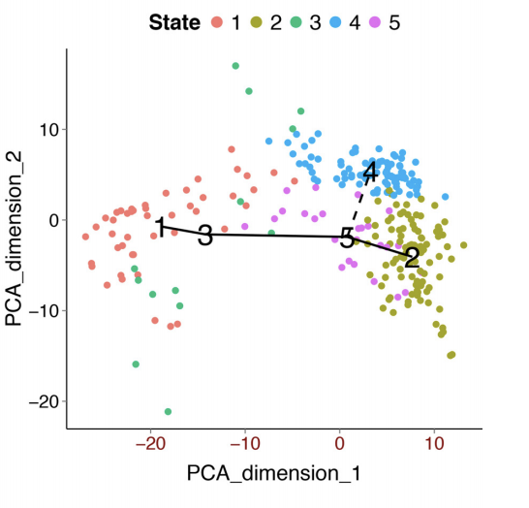
TSCAN (2016)
In silico pseudo-Time reconstruction in Single-Cell RNA-seq ANalysis

Slide 34
Example code for monocle
cds <- new_cell_data_set(expression_matrix,
cell_metadata = cell_metadata,
gene_metadata = gene_annotation)
cds <- preprocess_cds(cds, num_dim = 50)
cds <- align_cds(cds, alignment_group = "batch")
cds <- learn_graph(cds)
plot_cells(cds,
color_cells_by = "cell.type",
label_groups_by_cluster=FALSE,
label_leaves=TRUE,
label_branch_points=FALSE)

Slide 35
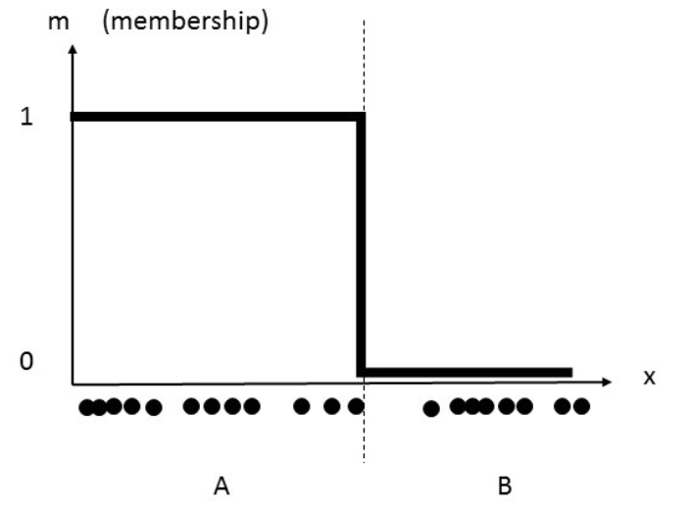
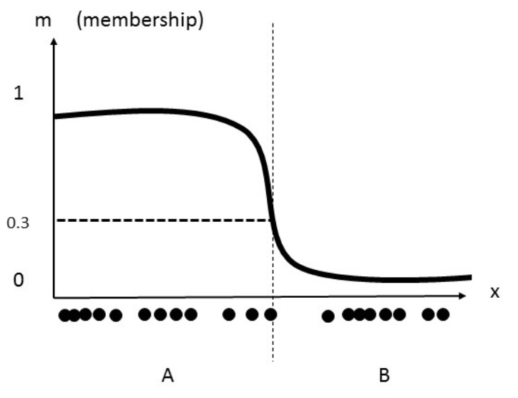
Soft-clustering
Also named fuzzy clustering
A form of clustering in which each data point can belong to more than one cluster
Compared to hard clustering, cells in soft clustering have probabilities that belonging to each cluster
Clusters are identified through similarity measures, e.g. distance, connectivity, intensity, etc.

Slide 36
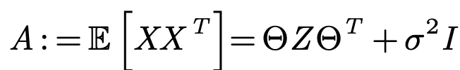
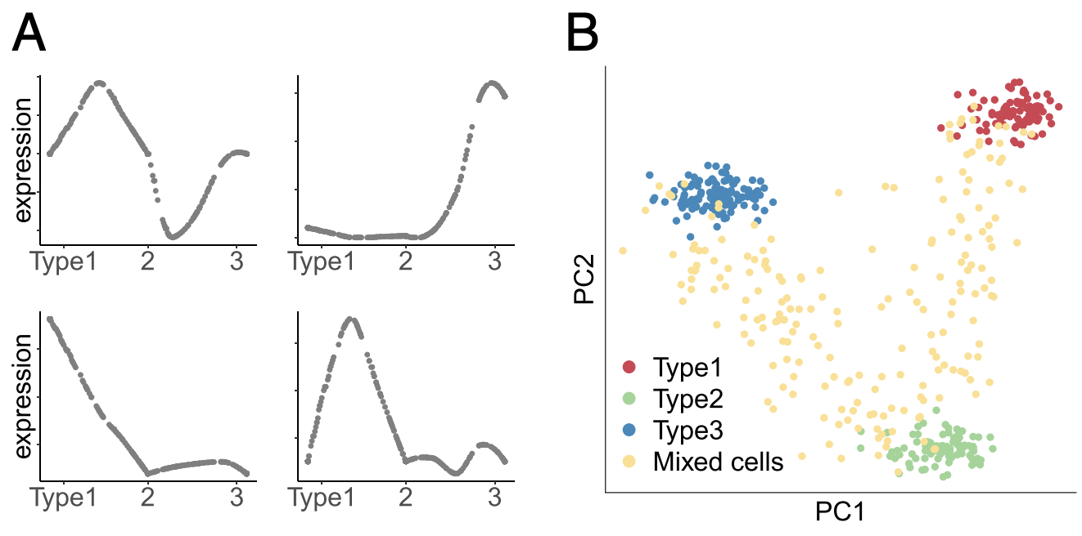
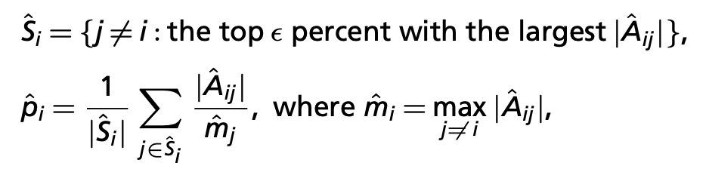
SOUP (2019)
Semisoft clustering: expect the existence of both pure cells, each belonging to a single cluster and requiring a hard cluster assignment, and mixed cells (transitional cells) that are transitioning between two or more cell types and hence should obtain soft assignments
1. Compute similarities:
2. Select pure cells:
3. Obtain membership for all the cells
Notes:
A: similarities

Slide 37
When does a cluster represent a new cell type?
“For a new cell type to be accepted, it is necessary to go beyond characterization of the transcriptome.”
A must: demonstrate that the newly identified cluster is also functionally distinct.
A good example: Villani et al. (2017) discovered new cell types from blood – differences in morphology, stimulation by pathogens and ability to activate T cells.

Slide 38
Future directions
Accurate and scalable clustering methods
How to best choose the number of clusters or what quality of antibody is required for a validation experiment
Determine how many marker genes are required to uniquely identify a specific cell type
There is also a need for methods that will facilitate biological interpretation and annotation

